Slide 1


Slide 2
Lec 4
Controller
Request Object
Send Data View to Action by Different Method
Validate Data
Show Error Massage
Show Old Data

Slide 3
php artisan make:controller –h Controller
Description:
Create a new controller class
Usage:
make:controller [options] [--] <name>
Arguments:
name The name of the class
Options:
-m, --model[=MODEL] Generate a resource controller for the given model.
-r, --resource Generate a resource controller class.
--api Exclude the create and edit methods from the controller.
EX suggestion
php artisan make:controller EmpController -r -m emp

Slide 4
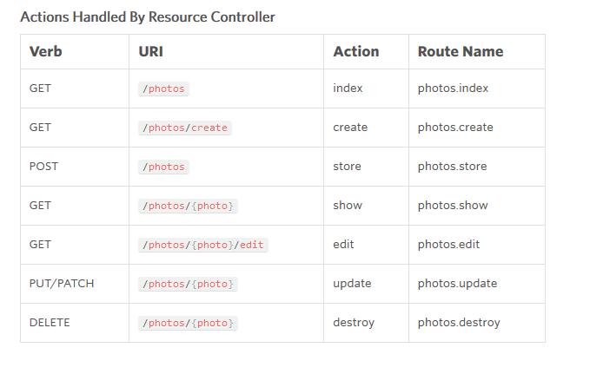
Controller resource

Slide 5
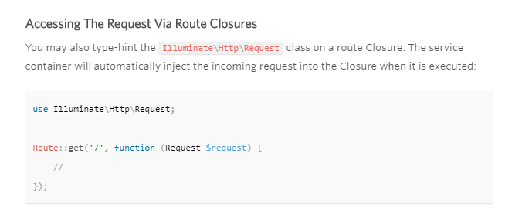
Request Accessing The Request
Illuminate\Http\Request

Slide 6
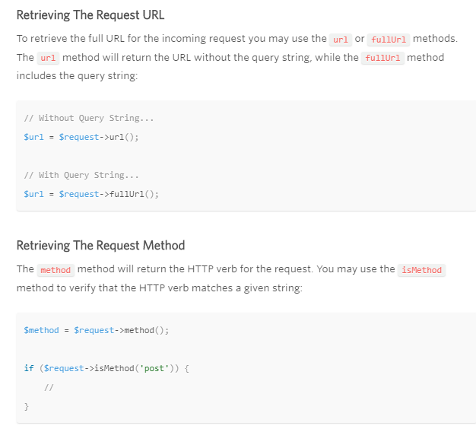
Request Path & Method

Slide 7
Request Retrieving Input
Illuminate\Http\Request
Illuminate\Support\Facades\Input;

Slide 8
Server Side Validate Data
Routing URL
Required Parameters
Regular Expression
Middleware
Request Validate
Request
Response

Slide 9
Validate Available Validation Rules
$request->validate([
'Email' => 'required',
'password' => 'required',
'MylogoPhoto' => 'required|image|mimes:jpeg,png,jpg,gif,svg'
]);

